Slide 1
Semantically Bridging Giovanni Data with Visualization

Slide 2
SemWeb and Visualization
Semantic Web: "web of data" that facilitates machine understanding of semantics
Ontologies: represent relationships within a domain
Reasoning: deriving additional relationships from asserted
Visualization: translating information into meaningful graphical presentations
VisKo is a framework that leverages the semantic Web to automate visualization
Vis process construction
Vis process execution

Slide 3
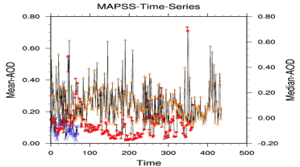
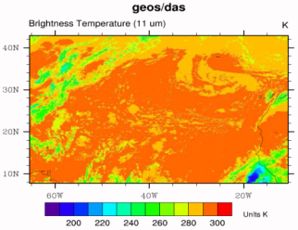
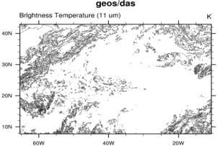
Linking Data with Visualization (VisKo)
VisKo
Vis. Ontology
VisKo infers relationships between data and visualization processes
Giovanni Data
Vis. Pipeline
VisKo infers sequences of vis. operators (i.e. pipeline)
Visualizations

Slide 4
Challenges
VisKo
How can we characterize new data so that VisKo can understand it and link it to visualization processes?
What kinds of services do we need to register with VisKo to support the visualization scenarios associated with new data?
Vis. Ontology
Giovanni Data
Vis. Pipeline
Visualizations

Slide 5
Benefits and Requirements
Data is matched up with visualization processes at logical levels (i.e., ontologies)
No hard-coded relationships
Semantic Web automatically infers relationships
Plug and play environment
Requires semantic characterization of data
Formats and Types defined in Proof Markup Language (PML)
Requires characterization of vis. services
Input/output formats
Description of output views (i.e. isolines/surfaces)
Characterization encoded in VisKo Description Language (VisKo-DL)

Slide 6
Why Target GES DISC Giovanni?
Giovanni vis. module does not have reusable knowledge about:
The conceptual relationships between data and visualization processes
The structure and semantics of data
The visualization process as sets of reusable service chains (i.e. pipelines)
Consequently, vis. module may not be easily adapted to new scenarios because of:
Hard coded relationships between data and vis.
Regards for data as holistic entities
Consolidation of entire visualization processes into single “black-box” services
VisKo can address these concerns and enable a true plug and play visualization environment

Slide 7
Giovanni-VisKo Integration Method
Understand how to characterize Giovanni data
What information can we leverage from Giovanni?
Is there any meta-data logged by the system?
What does Giovanni currently use?
Understand what is missing in VisKo
Does it have the right visualization services registered?
Does it generate the visualization at the quality expected by Giovanni
Understand how Giovanni provenance can be propagated through the visualization process

Slide 8
Giovanni-VisKo Results
Data characterization:
Identified data formats and semantic types from XML lineage
<output type="netCDF”> → PMLP:Format
<input- name="D1">MYD04_L2.051:AOD0470corr-l:medn> → PMLP:Information
Registered NCL Services:
gsn_csm_xy2 → to render Aerostat time series
gsn_csm_contour_map → to render brightness-temperature data
Provenance:
Developed module to translate Giovanni XML lineage to PML
Linked Giovanni data PML to VisKo visualization PML

Slide 9
Conclusions
Giovanni itself was not infused with VisKo:
We linked the data but Giovanni is not forwarding requests to VisKo
PML descriptions of Giovanni data service as the link
Demonstrated VisKo is a viable option for replacing Giovanni vis.
We can characterize data beyond type and format
Dimensionality, continuous vs. discrete
Need more expressive language than PML (i.e., custom data ontology)
Need to present PML along with plots to users
Our new PML describes both Giovanni data processing and VisKo vis.
Need to determine what are the relevant aspects to be presented

